Slide 1

HEALTH COMPANION
Rakshit Gupta Ayushmaan Singh Jamwal
Ankush Raina

Slide 2


Problem Statement:
Many people struggle to access timely healthcare solutions, leading to undetected health issues and delayed treatments.
Limited understanding of personal health metrics.
Difficulty in reaching healthcare professionals.
Lack of preventive measures resulting in avoidable health risks.

Slide 3

Proposed Solution
Introducing Health Companion, a user-friendly healthcare platform designed to empower individuals with proactive health monitoring tools.
Giving you simple tools to track your health, like BMI and calories.
Using smart and user-friendly tech to predict if you might have health issues.
Giving personalized advice to help you stay healthy and catch problems early.
Recommending doctors and remedies if a health issue is predicted, ensuring timely help and guidance.

Slide 4

How It Works
Data Collection: Users input their health data through the app.
Analysis: Advanced algorithms such as Logistic Regression and Machine Learning models analyze the data to provide valuable health insights.
Recommendations: Health Companion offers personalized recommendations and connects users with relevant healthcare professionals for further assistance.

Slide 5


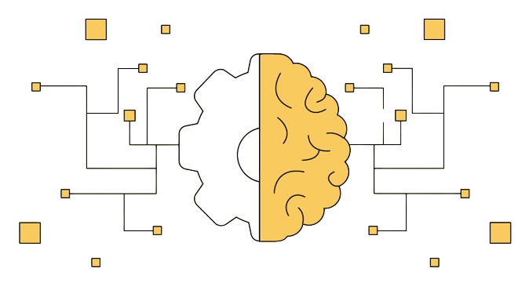


Technology Stack Used
Frontend: Developed using HTML and CSS for styling.
Backend: Powered by Flask, a Python web framework.
Database: MySQL is utilized for data storage.
Machine Learning: Algorithms like Logistic Regression for predictive analysis.

Slide 6

Additional Features
Doctor Recommendations: Connecting users with relevant healthcare professionals based on their health data.
Remedies Information: Providing guidance on remedies and preventive measures for identified health risks.
Disease Insights: Offering detailed information about various diseases and health conditions for user education.

Slide 7
THANK
YOU

